Slide 1
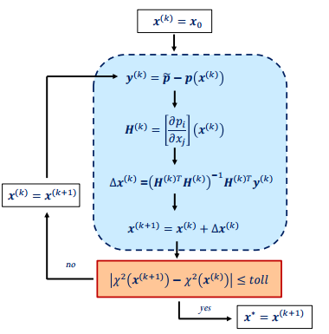

$$\left\|Δ(x^{ (k+1)})\right\|−\left\|Δ\left(x^{ \left(k\right)}\right)\right\|≤toll$$

Slide 2


$$∆x^{(k)}={(H^{\left(k\right)T}W^{(k)}H^{\left(k\right)})}^{−1}H^{\left(k\right)T}W^{(k)}y^{\left(k\right)}$$
$$\left\|Δ(x^{ (k+1)})\right\|−\left\|Δ\left(x^{ \left(k\right)}\right)\right\|≤toll$$

